Slide 1
The Enhanced Greenhouse Effect

Slide 2
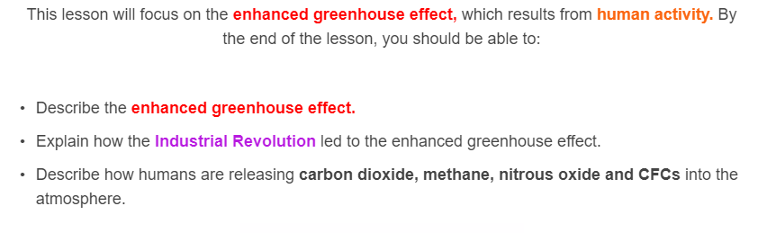
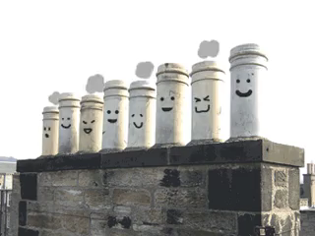

Slide 3
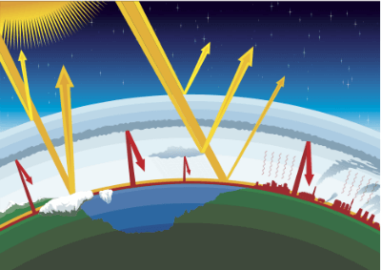
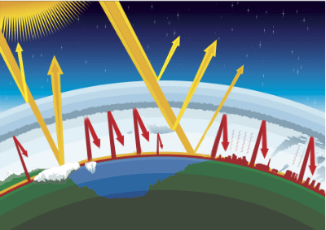

The natural greenhouse effect keeps the planet at a comfortable living temperature.
The enhanced greenhouse effect refers specifically to the intensification of the natural process, due to human activity. The Industrial Revolution is a key event linked to the rise of the enhanced greenhouse effect.

Slide 4
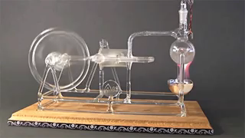
In the late 18th century, humans entered the Industrial Revolution. This was a period of significant growth and advancement, largely thanks to the development of the steam engine.
A steam engine burns fuel to boil water and produce steam. The steam turns a turbine or pumps a piston that can be adapted to perform various tasks, such as turning wheels.
Even today, much of our power still comes from steam turning turbines or pumping pistons, we're just finding cooler ways to produce the steam!

Slide 5
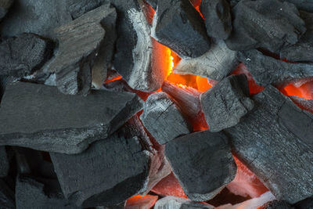
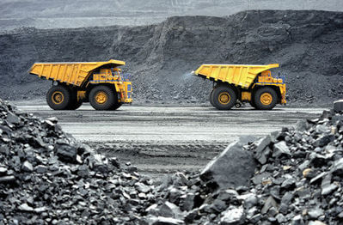
Before the Industrial Revolution, the most common fuel was charcoal. Charcoal is wood that has had all the moisture removed by heating it in the absence of oxygen. Making charcoal is time-consuming and difficult, and can be ruined if any oxygen gets in at the wrong time.
During the Industrial Revolution, the preferred fuel became coal. Coal only needed to be dug out of the ground, compared to the relatively difficult task of making charcoal.

Slide 6
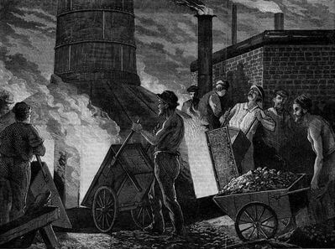
The carbon inside coal has been stored in the lithosphere for millions of years. Burning coal in such large quantities rapidly releases carbon, mostly as carbon dioxide (CO_{2​}), into the atmosphere, intensifying the greenhouse effect.
The burning of coal during the Industrial Revolution marked the beginning of the enhanced greenhouse effect.
For comparison, the carbon inside charcoal has usually only been stored for about 10−100 years.

Slide 7
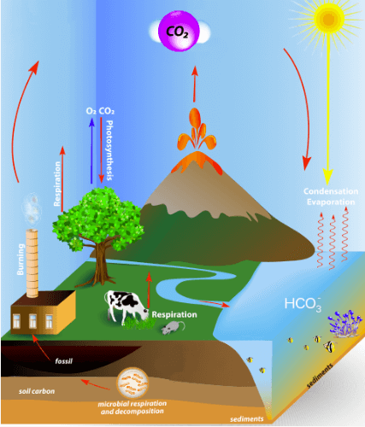
Imagine you are the carbon cycle. Your job is to move carbon through all the spheres and keep everything balanced. A big issue is keeping the amount of carbon dioxide in the atmosphere at the right levels, to maintain a consistent, comfortable temperature.

Slide 8
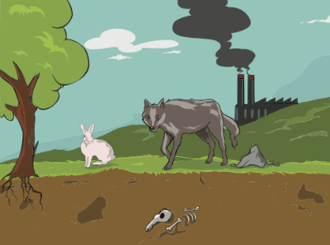
Suddenly, humans start moving carbon from the lithosphere into the atmosphere!
You try to fix this imbalance, but it takes millions of years to make the coal that they're burning so quickly. Carbon begins to build up in the atmosphere and the greenhouse effect begins intensifying.
This is the danger of an imbalance in the carbon cycle; natural processes just can't remove carbon from the atmosphere as quickly as we add it.

Slide 9

But, hang on! Why can't the carbon cycle handle the increase in atmospheric carbon?
The carbon cycle needs a similar number of carbon sources and carbon sinks to ensure that the movement of carbon through the spheres remains balanced. When we burn fossil fuels, we are adding a new and significant source of atmospheric carbon without adding a counteractive carbon sink.
Carbon starts to accumulate in the atmosphere because it cannot be removed and has nowhere to go. This intensifies the enhanced greenhouse effect!

Slide 10
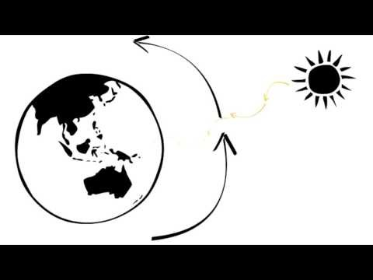

Slide 11
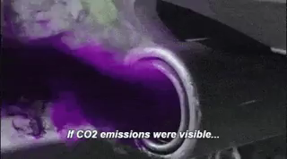
The Industrial Revolution was just the beginning for the intensification of the enhanced greenhouse effect. Since then, humans have found more ways to release greenhouse gases into the atmosphere.
The four major types of emissions that we will investigate in this section are:
⋅ | Carbon dioxide
⋅ | Methane
⋅ | Nitrous oxide
⋅ | CFCs

Slide 12
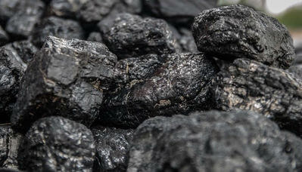
Carbon dioxide emissions from human activity were the first significant contributor to the enhanced greenhouse effect and still account for roughly 84% of our greenhouse gas emissions.
Carbon dioxide is a product of burning fossil fuels, such as coal, gas and oil. As you are probably aware, we burn a huge amount of fossil fuels. The three main uses are transportation, producing power and industrial processes.
Coal produces almost 70% of Australia's electricity.

Slide 13
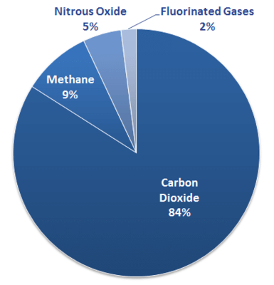
Carbon dioxide is the most abundant greenhouse gas in the atmosphere and lasts for up to 100 years in the atmosphere.
Water vapour can be more abundant, however this varies significantly depending on local conditions.

Slide 14
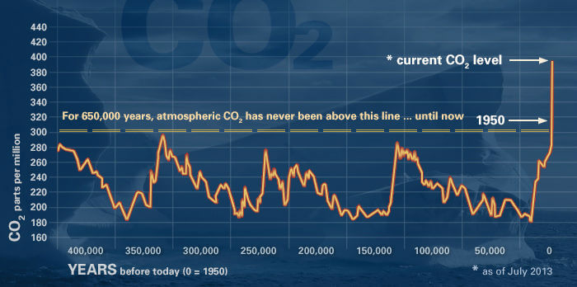
Atmospheric carbon dioxide levels have increased by 40% since the Industrial Revolution. They are currently higher than they have been in the last 650,000 years and possibly the last 20 million years!

Slide 15
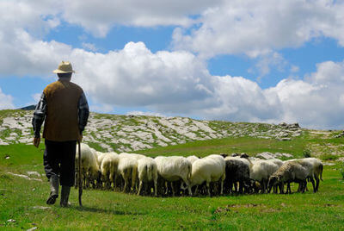

Methane is produced by livestock, such as sheep and cows, when they digest grass. Livestock account for 37% of our methane output.
Wetlands are a natural source of methane and rice paddies are just man-made wetlands. As human population increases, the amount of rice paddies increases and methane output increases. Rice paddies account for nearly 20% of our methane output.

Slide 16
Methane is less abundant in the atmosphere than carbon dioxide, however it is almost 30 times more effective at trapping heat.
Methane lasts roughly 10 years in the atmosphere.

Slide 17

Nitrous oxide is produced naturally from nitrogen in the lithosphere and biosphere. By using fertilisers, we are increasing the amount of nitrogen in these spheres, and therefore increasing the production of nitrous oxide.

Slide 18
Nitrous oxide is much less abundant than carbon dioxide, however it is roughly 300 times more effective at trapping heat.
Nitrous oxide lasts roughly 100 years in the atmosphere.

Slide 19
CFCs (chlorofluorocarbons) are compounds that contain only chlorine, fluorine and carbon. They were originally used in refrigerators and aerosol sprays.
Despite their low abundance, CFCs can last hundreds of years in the atmosphere and are thousands of times more effective than carbon dioxide at trapping heat.

Slide 20
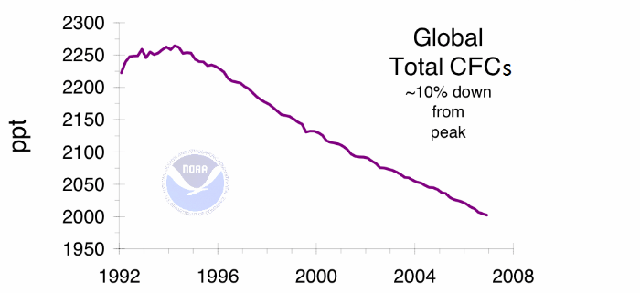
In the 1970’s, scientists discovered that atmospheric CFCs destroy ozone molecules. This destruction led to a hole in the ozone layer forming above Antarctica.
Fortunately, CFC usage has been phased out, thanks to the 1987 Montreal Protocol. As of 2012, 98% of CFC usage had been eliminated.
This graph shows CFC concentrations have been steadily dropping as the atmospheric CFCs degrade.

Slide 21

CFCs are a powerful example that it is possible for countries to work together and substantially reduce emissions.
There were only 14 years between the discovery that CFCs damaged the ozone layer and the signing of the Montreal Protocol!

